Slide 2
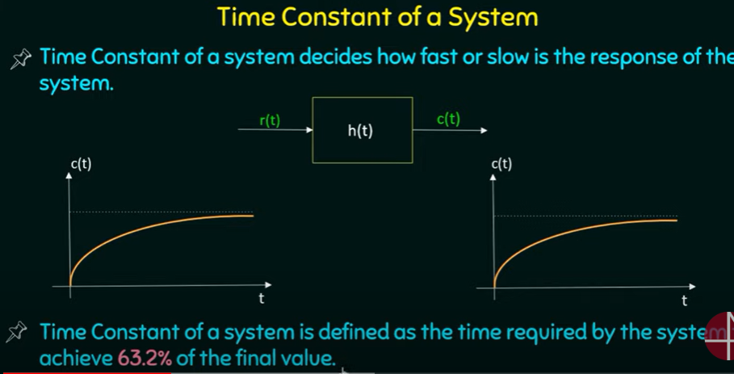

Slide 3
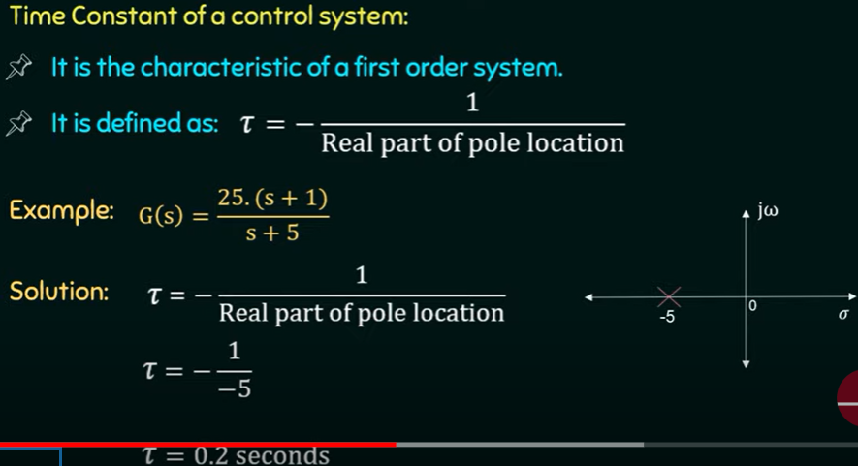

Slide 4
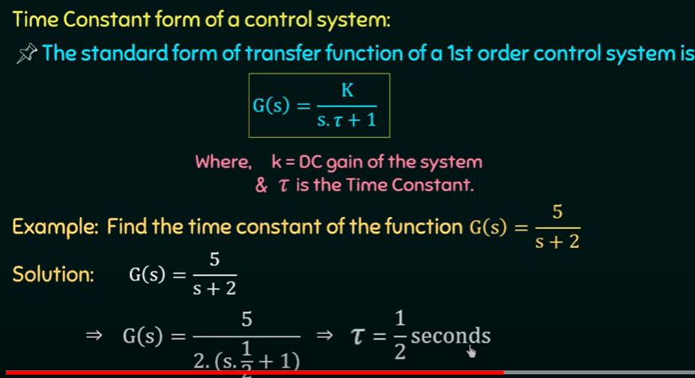

Slide 5
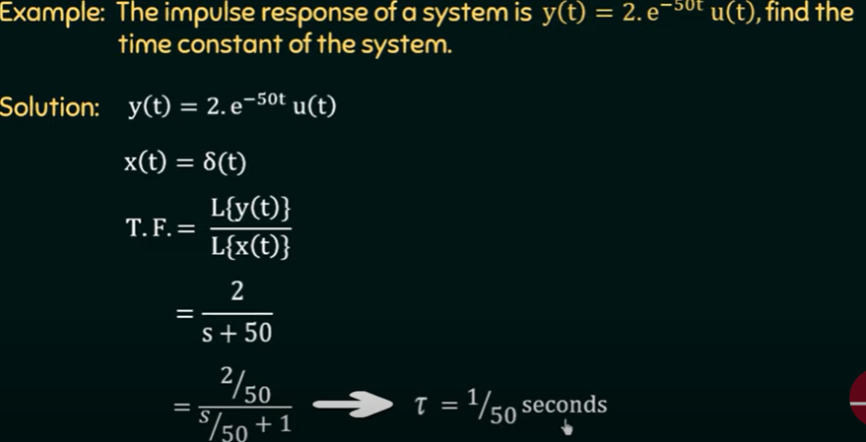

Slide 6
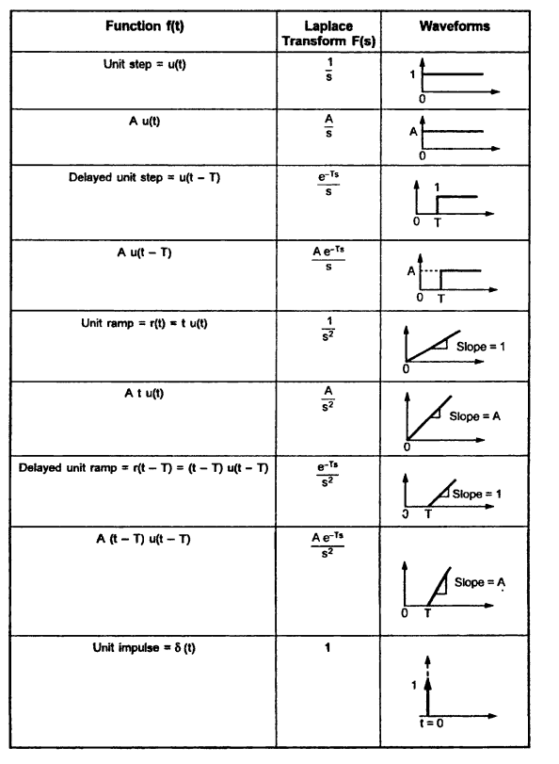
Time Domain Analysis

Slide 7
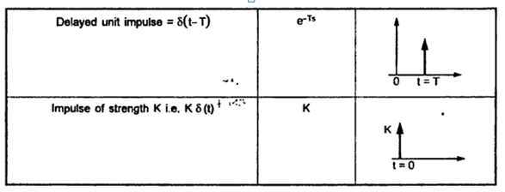

Slide 8
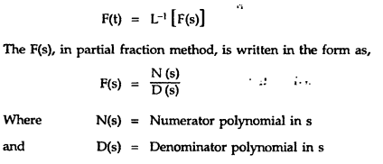

Slide 9
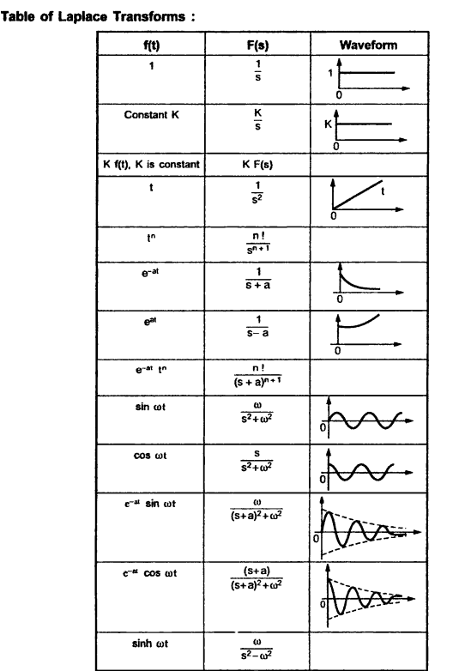

Slide 10
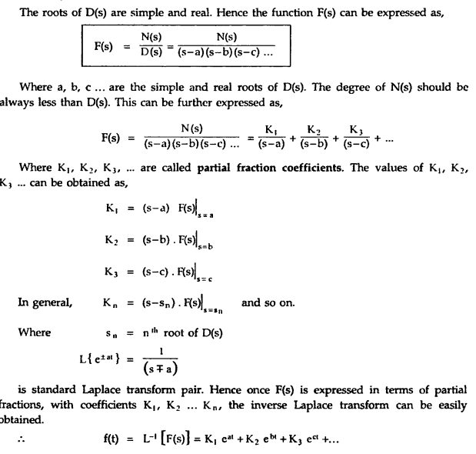

Slide 11
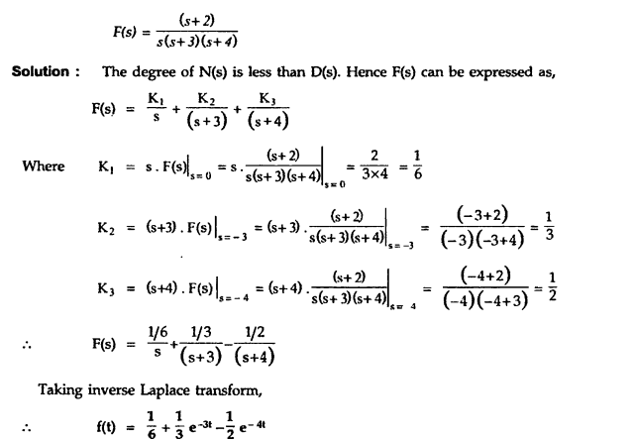

Slide 12
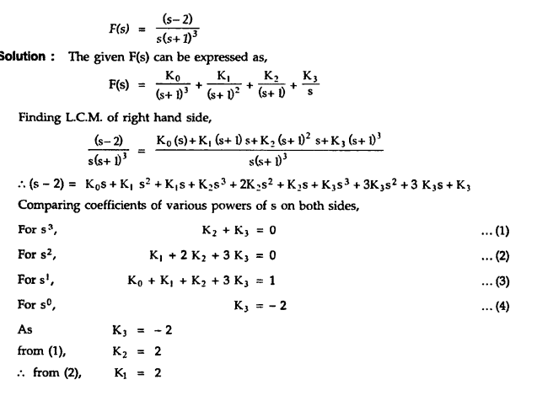
Multiple roots

Slide 13
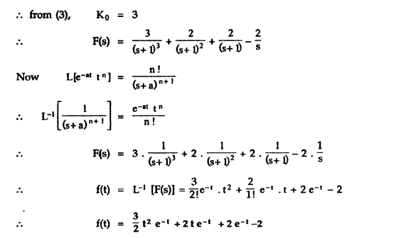

Slide 14
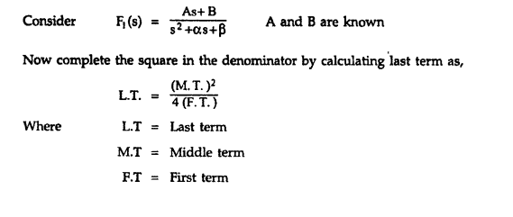
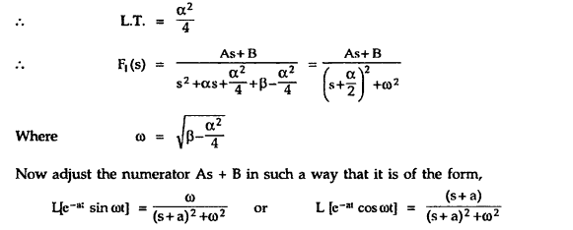
Complex conjugate roots

Slide 15
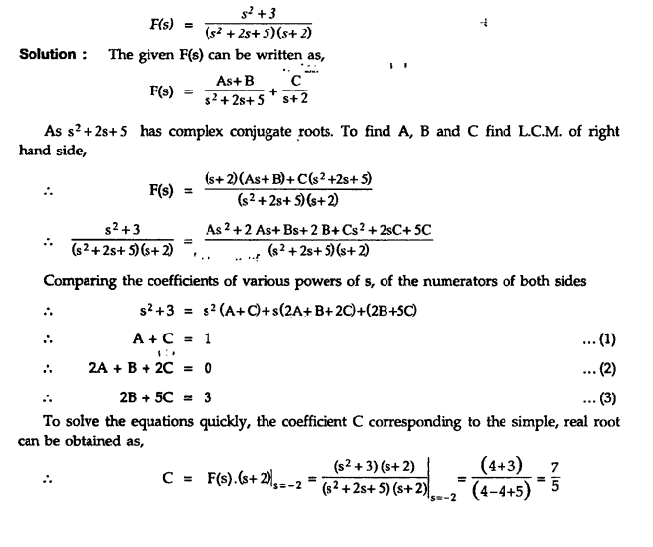

Slide 16
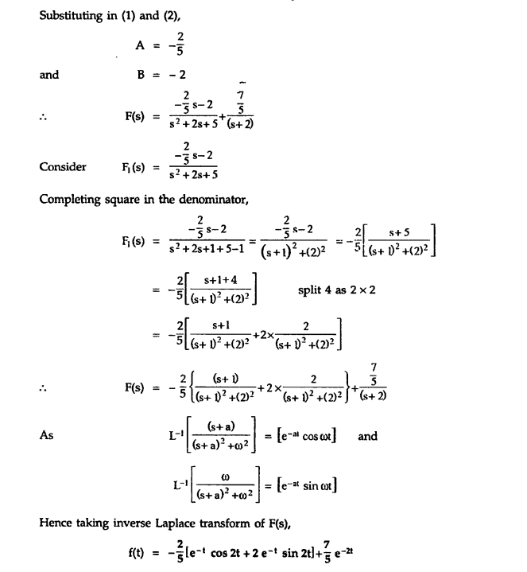

Slide 17
Introduction
In time-domain analysis the response of a dynamic system to an input is expressed as a function of time.
It is possible to compute the time response of a system if the nature of input and the mathematical model of the system are known.
Usually, the input signals to control systems are not known fully ahead of time.
It is therefore difficult to express the actual input signals mathematically by simple equations.

Slide 18
Standard Test Signals
The characteristics of actual input signals are a sudden shock, a sudden change, a constant velocity, and constant acceleration.
The dynamic behavior of a system is therefore judged and compared under application of standard test signals – an impulse, a step, a constant velocity, and constant acceleration.
The other standard signal of great importance is a sinusoidal signal.

Slide 19
Standard Test Signals
Impulse signal
The impulse signal imitate the sudden shock characteristic of actual input signal.
If A=1, the impulse signal is called unit impulse signal.
δ(t)
A
0
t

Slide 20
Standard Test Signals
Step signal
Instantaneous jump in amplitude
If A=1, - unit step signal
The step signal imitate the sudden change characteristic of actual input signal.
u(t)
A
0
t

Slide 21
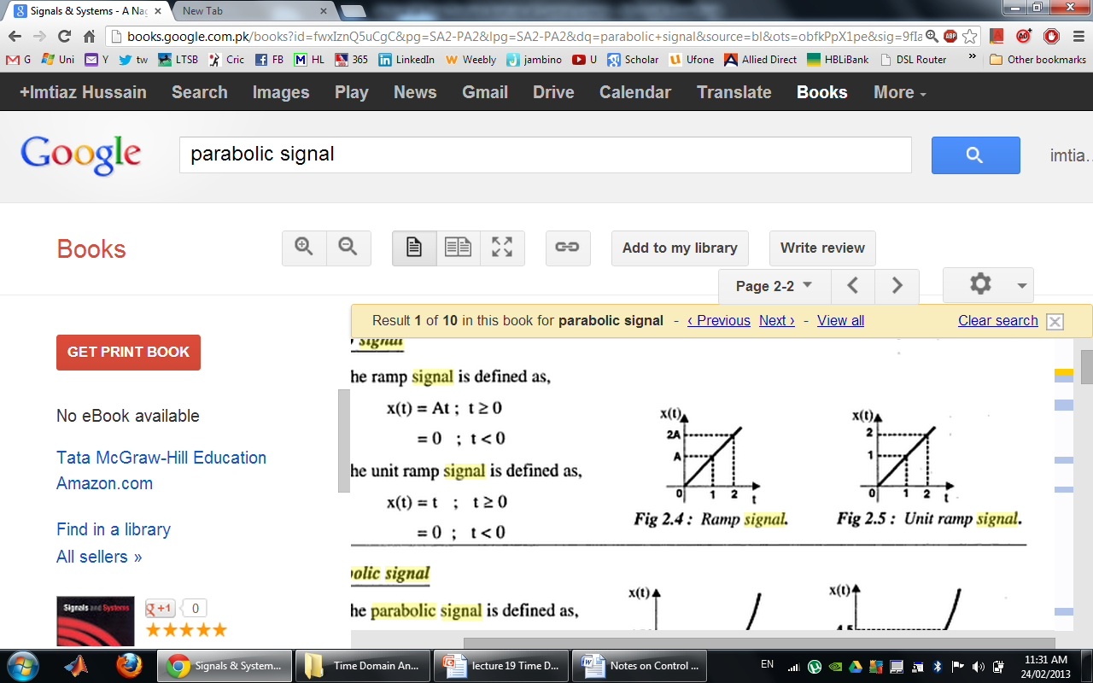
Standard Test Signals
Ramp signal
The ramp signal imitate the constant velocity characteristic of actual input signal.
If A=1, the ramp signal is called unit ramp signal
r(t)
0
t
r(t)
ramp signal with slope A
r(t)
unit ramp signal

Slide 22
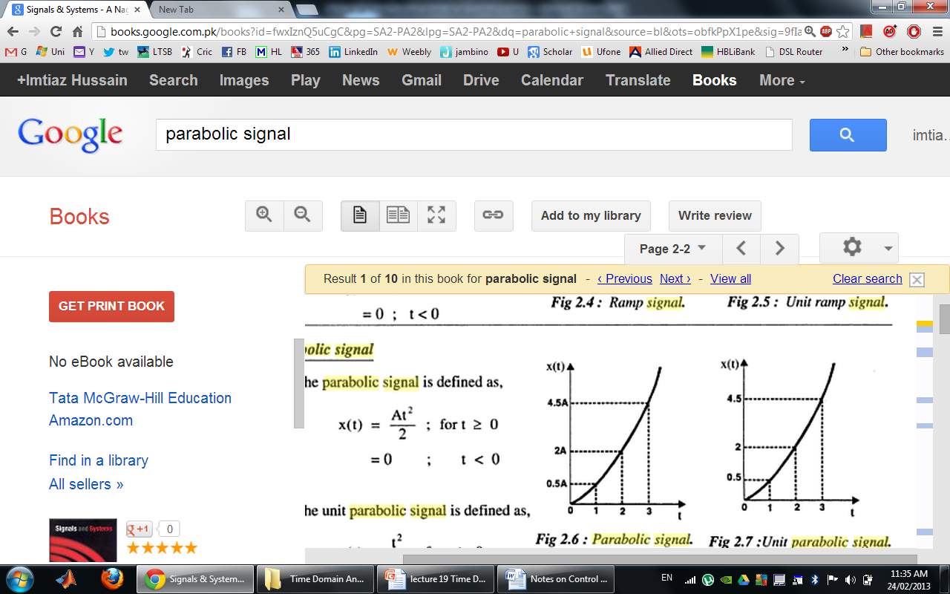
Standard Test Signals
Parabolic signal
The parabolic signal imitate the constant acceleration characteristic of actual input signal.
If A=1, the parabolic signal is called unit parabolic signal.
p(t)
0
t
p(t)
parabolic signal with slope A
p(t)
Unit parabolic signal

Slide 23
Relation between standard Test Signals
Impulse
Step
Ramp
Parabolic

Slide 24
Laplace Transform of Test Signals
Impulse
Step

Slide 25
Laplace Transform of Test Signals
Ramp
Parabolic

Slide 26
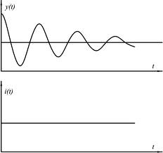
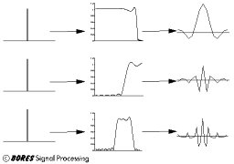
Time Response of Control Systems
Time response of a dynamic system response to an input expressed as a function of time.
System
The time response of any system has two components
Transient response
Steady-state response.

Slide 27
Time Response of Control Systems
When the response of the system is changed from equilibrium it takes some time to settle down.
This is called transient response.
The response of the system after the transient response is called steady state response.
Steady State Response
Transient Response

Slide 28
Time Response of Control Systems
Transient response depend upon the system poles only and not on the type of input.
It is therefore sufficient to analyze the transient response using a step input.
The steady-state response depends on system dynamics and the input quantity.
It is then examined using different test signals by final value theorem.

Slide 29
Introduction
The first order system has only one pole.
Where K is the D.C gain and T is the time constant of the system.
Time constant is a measure of how quickly a 1st order system responds to a unit step input.
D.C Gain of the system is ratio between the input signal and the steady state value of output.

Slide 30
Introduction
The first order system given below.
D.C gain is 10 and time constant is 3 seconds.
For the following system
D.C Gain of the system is 3/5 and time constant is 1/5 seconds.

Slide 31
Impulse Response of 1st Order System
Consider the following 1st order system
δ(t)
1
0
t

Slide 32
Impulse Response of 1st Order System
Re-arrange following equation as
In order to compute the response of the system in time domain we need to compute inverse Laplace transform of the above equation.

Slide 33
Impulse Response of 1st Order System
If K=3 and T=2s then

Slide 34
Step Response of 1st Order System
Consider the following 1st order system
In order to find out the inverse Laplace of the above equation, we need to break it into partial fraction expansion (page 867 in the Textbook)

Slide 35
Step Response of 1st Order System
Taking Inverse Laplace of above equation
Where u(t)=1
When t=T (time constant)

Slide 36
Step Response of 1st Order System
If K=10 and T=1.5s then

Slide 37
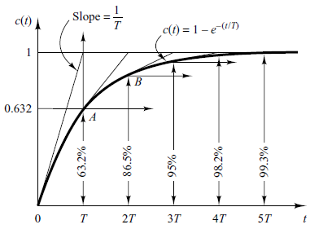
Step Response of 1st order System
System takes five time constants to reach its final value.

Slide 38
Step Response of 1st Order System
If K=10 and T=1, 3, 5, 7

Slide 39
Step Response of 1st Order System
If K=1, 3, 5, 10 and T=1

Slide 40
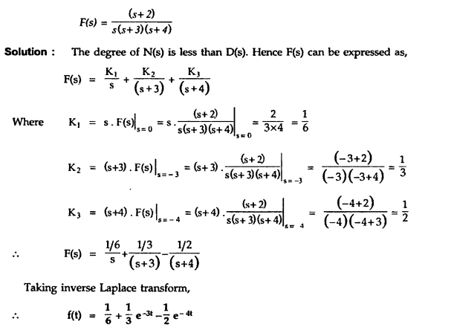
Finding laplace inverse

Slide 41
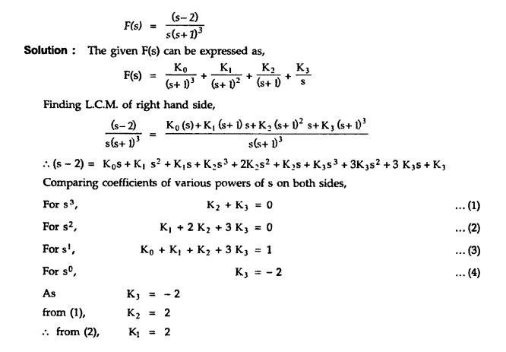

Slide 42
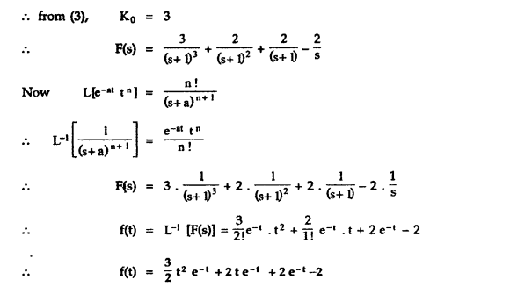

Slide 43
Relation Between Step and impulse response
The step response of the first order system is
Differentiating c(t) with respect to t yields

Slide 44
Analysis of Simple RC Circuit
i(t)
R
v_{T}(t)
C
v(t)
±
state variable
Input
waveform

Slide 45
Analysis of Simple RC Circuit
Step-input response:
v₀u(t)
match initial state:
v₀
v₀(1-e^{-t/RC})u(t)
output response for step-input:

Slide 46
RC Circuit
v(t) = v₀(1 - e^{-t/RC}) -- waveform
under step input v₀u(t)
v(t)=0.5v₀ ⇒ t = 0.69RC
i.e., delay = 0.69RC (50% delay)
v(t)=0.1v₀ ⇒ t = 0.1RC
v(t)=0.9v₀ ⇒ t = 2.3RC
i.e., rise time = 2.2RC (if defined as time from 10% to 90% of Vdd)
For simplicity, industry uses T_{D} = RC (= Elmore delay)

Slide 47
Elmore Delay
50%-50% point delay
Delay=0.69RC
Delay

Slide 48
Example 1
Impulse response of a 1st order system is given below.
Find out
Time constant T
D.C Gain K
Transfer Function
Step Response

Slide 49
Example 1
The Laplace Transform of Impulse response of a system is actually the transfer function of the system.
Therefore taking Laplace Transform of the impulse response given by following equation.

Slide 50
Example 1
Impulse response of a 1st order system is given below.
Find out
Time constant T=2
D.C Gain K=6
Transfer Function
Step Response

Slide 51
Example 1
For step response integrate impulse response
We can find out C if initial condition is known e.g. c_{s}(0)=0

Slide 52
Example 1
If initial conditions are not known then partial fraction expansion is a better choice

Slide 53
Ramp Response of 1st Order System
Consider the following 1st order system
The ramp response is given as

Slide 54
Parabolic Response of 1st Order System
Consider the following 1st order system
Therefore,

Slide 55
Practical Determination of Transfer Function of 1st Order Systems
Often it is not possible or practical to obtain a system's transfer function analytically.
Perhaps the system is closed, and the component parts are not easily identifiable.
The system's step response can lead to a representation even though the inner construction is not known.
With a step input, we can measure the time constant and the steady-state value, from which the transfer function can be calculated.

Slide 56
Practical Determination of Transfer Function of 1st Order Systems
If we can identify T and K empirically we can obtain the transfer function of the system.

Slide 57
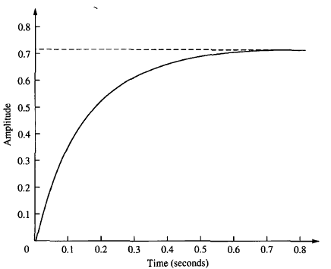
Practical Determination of Transfer Function of 1st Order Systems
For example, assume the unit step response given in figure.
K=0.72
From the response, we can measure the time constant, that is, the time for the amplitude to reach 63% of its final value.
Since the final value is about 0.72 the time constant is evaluated where the curve reaches 0.63 x 0.72 = 0.45, or about 0.13 second.
T=0.13s
Thus transfer function is obtained as:
K is simply steady state value.

Slide 58
First Order System with a Zero
Zero of the system lie at -1/α and pole at -1/T.
Step response of the system would be:

Slide 59
First Order System With Delays
Following transfer function is the generic representation of 1st order system with time lag.
Where t_{d} is the delay time.

Slide 60
First Order System With Delays
1
Unit Step
Step Response
t
t_{d}

Slide 61
First Order System With Delays

Slide 62
Second Order System
We have already discussed the affect of location of poles and zeros on the transient response of 1st order systems.
Compared to the simplicity of a first-order system, a second-order system exhibits a wide range of responses that must be analyzed and described.
Varying a first-order system's parameter (T, K) simply changes the speed and offset of the response
Whereas, changes in the parameters of a second-order system can change the form of the response.
A second-order system can display characteristics much like a first-order system or, depending on component values, display damped or pure oscillations for its transient response.

Slide 63
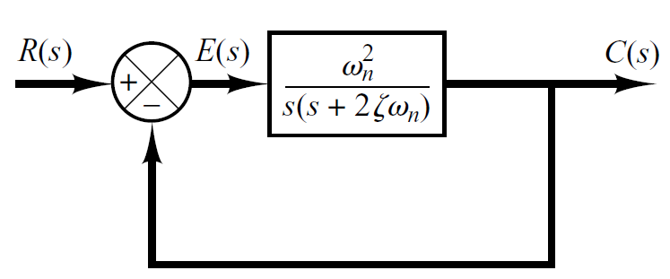
Introduction
A general second-order system is characterized by the following transfer function.
un-damped natural frequency of the second order system, which is the frequency of oscillation of the system without damping.
damping ratio of the second order system, which is a measure of the degree of resistance to change in the system output.

Slide 64
Example 2
Determine the un-damped natural frequency and damping ratio of the following second order system.
Compare the numerator and denominator of the given transfer function with the general 2nd order transfer function.

Slide 65
Introduction
Two poles of the system are

Slide 66
Introduction
According the value of , a second-order system can be set into one of the four categories (page 169 in the textbook):
Overdamped - when the system has two real distinct poles ( >1).
jω
δ
-c
-b
-a

Slide 67
Introduction
According the value of , a second-order system can be set into one of the four categories (page 169 in the textbook):
2. Underdamped - when the system has two complex conjugate poles (0 < <1)
jω
δ
-c
-b
-a

Slide 68
Introduction
According the value of , a second-order system can be set into one of the four categories (page 169 in the textbook):
3. Undamped - when the system has two imaginary poles ( = 0).
jω
δ
-c
-b
-a

Slide 69
Introduction
According the value of , a second-order system can be set into one of the four categories (page 169 in the textbook):
4. Critically damped - when the system has two real but equal poles ( = 1).
jω
δ
-c
-b
-a

Slide 70
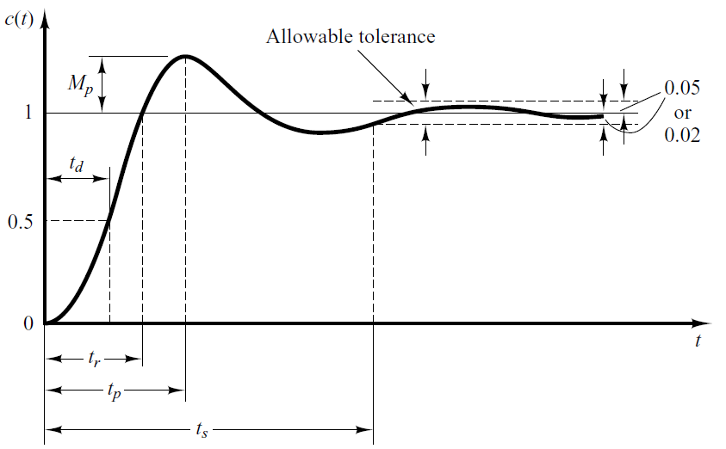
Underdamped System
For 0< <1 and ω_{n} > 0, the 2nd order system’s response due to a unit step input is as follows.
Important timing characteristics: delay time, rise time, peak time, maximum overshoot, and settling time.

Slide 71
Delay Time
The delay (t_{d}) time is the time required for the response to reach half the final value the very first time.

Slide 72
Rise Time
The rise time is the time required for the response to rise from 10% to 90%, 5% to 95%, or 0% to 100% of its final value.
For underdamped second order systems, the 0% to 100% rise time is normally used. For overdamped systems, the 10% to 90% rise time is commonly used.
72

Slide 73
Peak Time
The peak time is the time required for the response to reach the first peak of the overshoot.
73
73

Slide 74

Maximum Overshoot
The maximum overshoot is the maximum peak value of the response curve measured from unity. If the final steady-state value of the response differs from unity, then it is common to use the maximum percent overshoot. It is defined by
The amount of the maximum (percent) overshoot directly indicates the relative stability of the system.

Slide 75
Settling Time
The settling time is the time required for the response curve to reach and stay within a range about the final value of size specified by absolute percentage of the final value (usually 2% or 5%).

Slide 76
Step Response of underdamped System
Step Response
The partial fraction expansion of above equation is given as

Slide 77
Step Response of underdamped System
Above equation can be written as
Where , is the frequency of transient oscillations and is called damped natural frequency.
The inverse Laplace transform of above equation can be obtained easily if C(s) is written in the following form:

Slide 78
Step Response of underdamped System

Slide 79
Step Response of underdamped System
When

Slide 80
Step Response of underdamped System

Slide 81
Step Response of underdamped System

Slide 82
Step Response of underdamped System

Slide 83
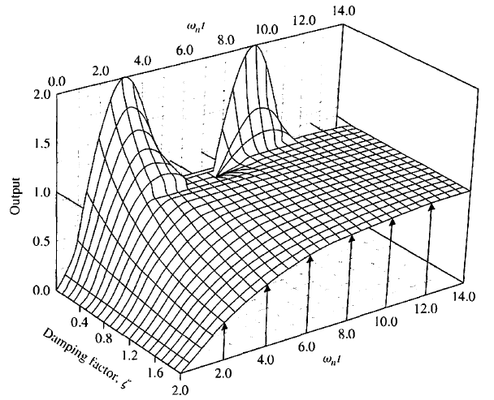
Step Response of underdamped System

Slide 84
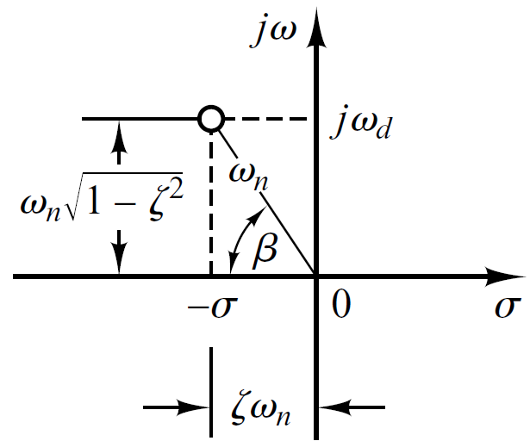
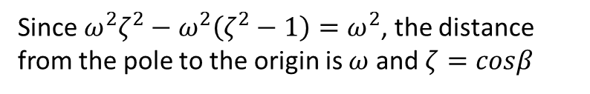
S-Plane (Underdamped System)
Since $ω^{2}ζ^{2}−ω^{2}\left(ζ^{2}−1\right)=ω^{2}$, the distance from the pole to the origin is $ω$ and $ζ=cosβ$

Slide 85
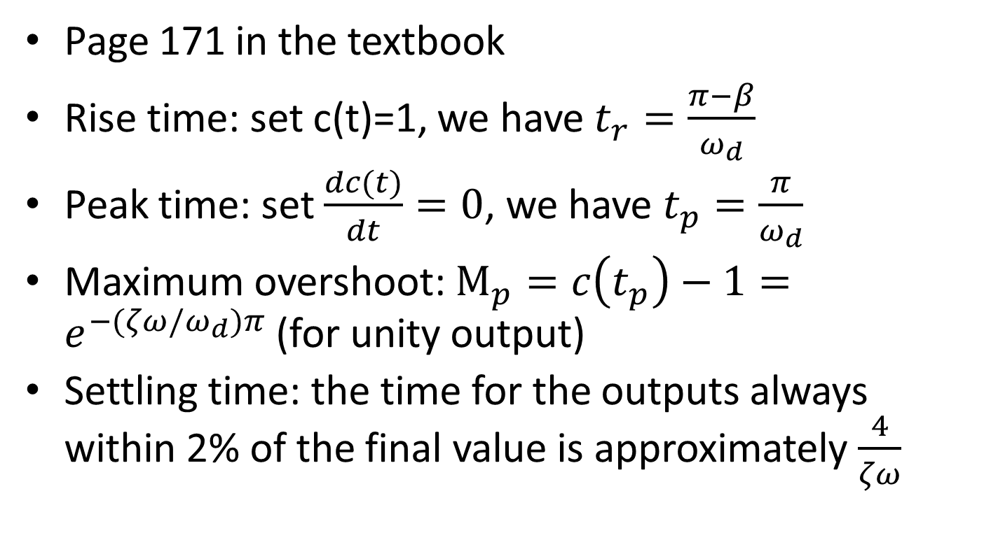
Analytical Solution
Page 171 in the textbook
Rise time: set c(t)=1, we have $t_{r}=\frac{π−β}{ω_{d}}$
Peak time: set $\frac{dc(t)}{dt}=0$, we have $t_{p}=\frac{π}{ω_{d}}$
Maximum overshoot: $M_{p}=c\left(t_{p}\right)−1=e^{−(ζω/ω_{d})π}$ (for unity output)
Settling time: the time for the outputs always within 2% of the final value is approximately $\frac{4}{ζω}$

Slide 86
Empirical Solution Using MATLAB
Page 242 in the textbook

Slide 87
Steady State Error
If the output of a control system at steady state does not exactly match with the input, the system is said to have steady state error
Any physical control system inherently suffers steady-state error in response to certain types of inputs.
Page 219 in the textbook
A system may have no steady-state error to a step input, but the same system may exhibit nonzero steady-state error to a ramp input.

Slide 88
Classification of Control Systems
Control systems may be classified according to their ability to follow step inputs, ramp inputs, parabolic inputs, and so on.
The magnitudes of the steady-state errors due to these individual inputs are indicative of the goodness of the system.

Slide 89
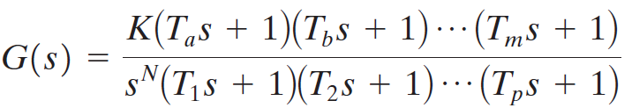
Classification of Control Systems
Consider the unity-feedback control system with the following open-loop transfer function
It involves the term s^{N} in the denominator, representing N poles at the origin.
A system is called type 0, type 1, type 2, ... , if N=0, N=1, N=2, ... , respectively.

Slide 90
Classification of Control Systems
As the type number is increased, accuracy is improved.
However, increasing the type number aggravates the stability problem.
A compromise between steady-state accuracy and relative stability is always necessary.

Slide 91
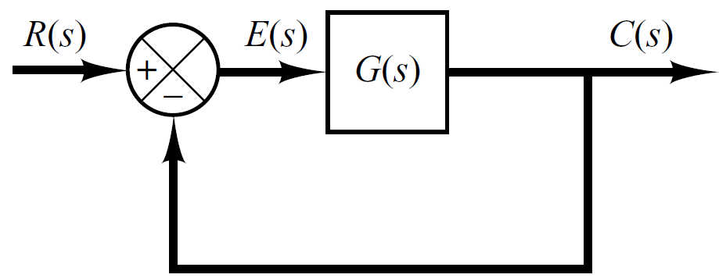

Steady State Error of Unity Feedback Systems
Consider the system shown in following figure.
The closed-loop transfer function is

Slide 92

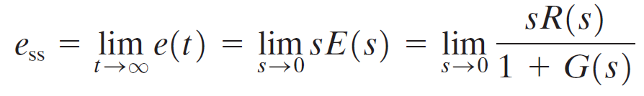
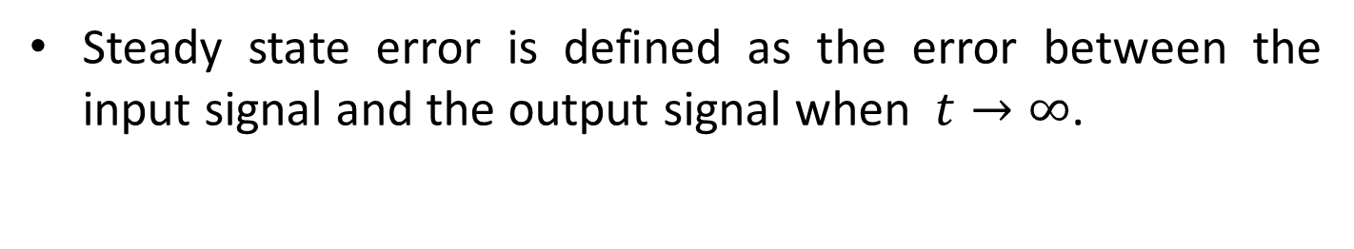
Steady State Error of Unity Feedback Systems
Steady state error is defined as the error between the input signal and the output signal when $t→∞$.
The transfer function between the error signal E(s) and the input signal R(s) is
The final-value theorem provides a convenient way to find the steady-state performance of a stable system.
Since E(s) is
The steady state error is

Slide 93
Static Error Constants
The static error constants are figures of merit of control systems. The higher the constants, the smaller the steady-state error.
In a given system, the output may be the position, velocity, pressure, temperature, or the like.
Therefore, in what follows, we shall call the output “position,” the rate of change of the output “velocity,” and so on.
This means that in a temperature control system “position” represents the output temperature, “velocity” represents the rate of change of the output temperature, and so on.

Slide 94
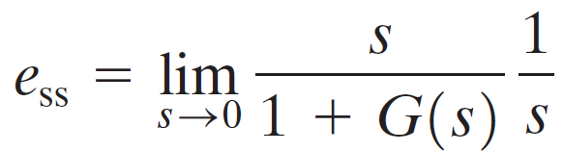
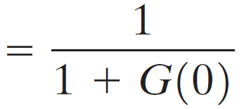
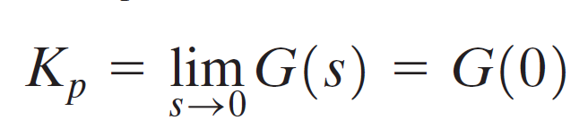
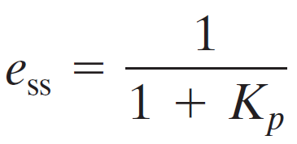
Static Position Error Constant (K_{p})
The steady-state error of the system for a unit-step input is
The static position error constant K_{p} is defined by
Thus, the steady-state error in terms of the static position error constant K_{p} is given by

Slide 95
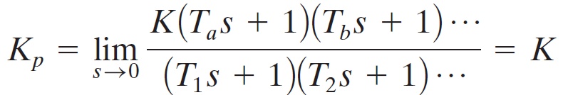
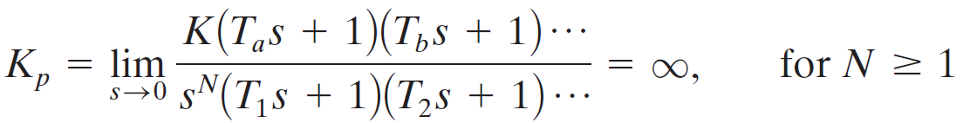
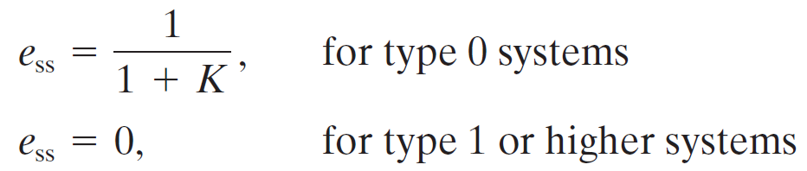
Static Position Error Constant (K_{p})
For a Type 0 system
For Type 1 or higher order systems
For a unit step input the steady state error e_{ss} is

Slide 96
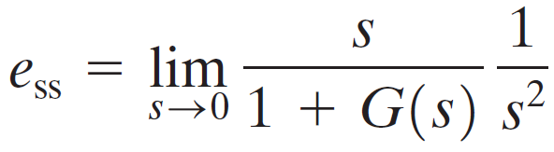
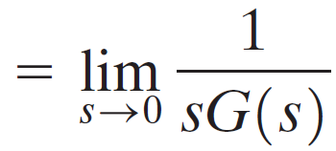

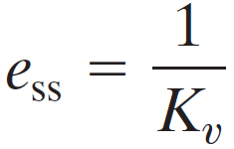
Static Velocity Error Constant (K_{v})
The steady-state error of the system for a unit-ramp input is
The static velocity error constant K_{v} is defined by
Thus, the steady-state error in terms of the static velocity error constant K_{v} is given by

Slide 97
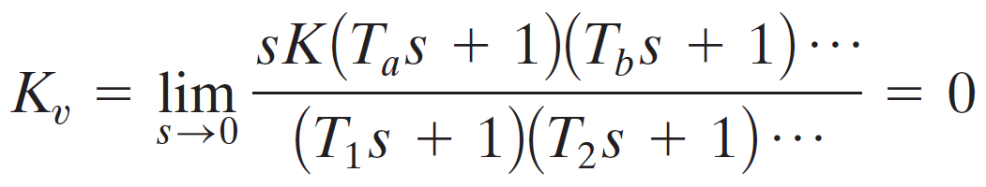
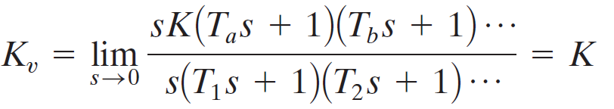
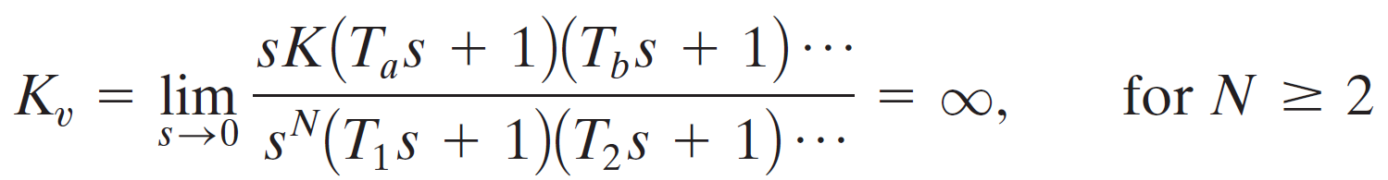
Static Velocity Error Constant (K_{v})
For a Type 0 system
For Type 1 systems
For type 2 or higher order systems

Slide 98
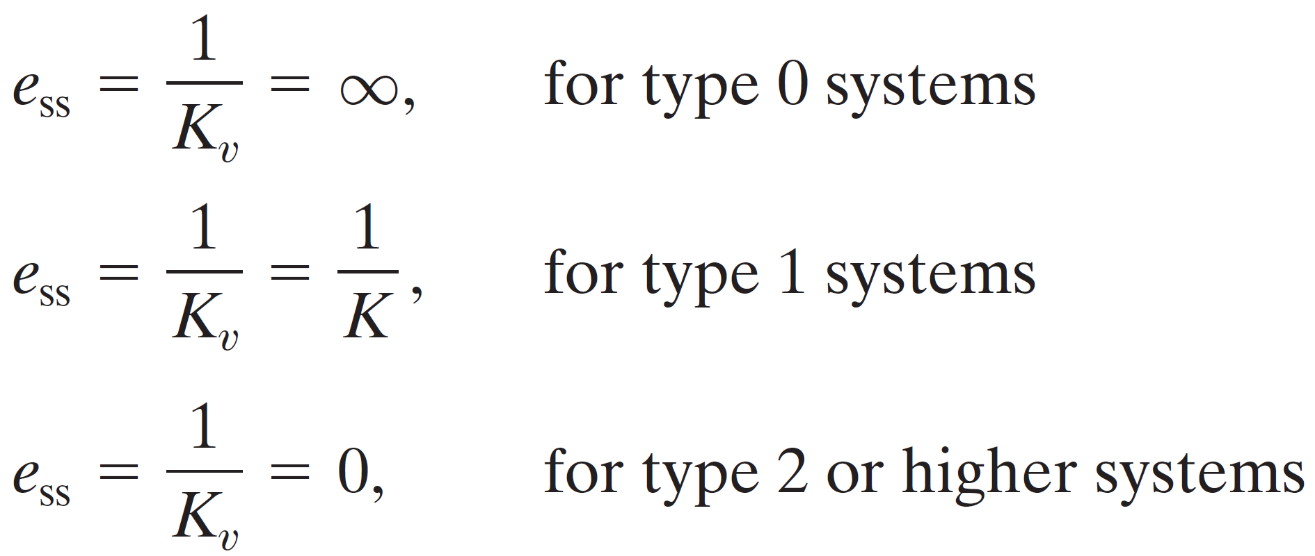
Static Velocity Error Constant (K_{v})
For a ramp input the steady state error e_{ss} is

Slide 99
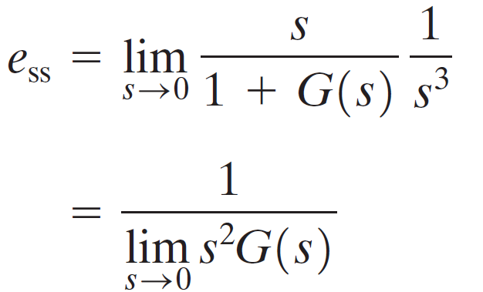


Static Acceleration Error Constant (K_{a})
The steady-state error of the system for parabolic input is
The static acceleration error constant K_{a} is defined by
Thus, the steady-state error in terms of the static acceleration error constant K_{a} is given by

Slide 100




Static Acceleration Error Constant (K_{a})
For a Type 0 system
For Type 1 systems
For type 2 systems
For type 3 or higher order systems

Slide 101

Static Acceleration Error Constant (K_{a})
For a parabolic input the steady state error e_{ss} is

Slide 102

Summary

Slide 103
Example 2
For the system shown in figure below evaluate the static error constants and find the expected steady state errors for the standard step, ramp and parabolic inputs.
R(S)
C(S)
-

Slide 104
Example 2

Slide 105
Example 2

